Slide 1
論文研究 建置動態旅運規劃系統之研究 Research on Dynamic Itinerary Planning System
陳 協 昌
AllenChen
2015/07/10

Slide 2
Outline
Introduction
Related Work
Methodology
Implementation
Evaluation
Conclusions and Future Work

Slide 3
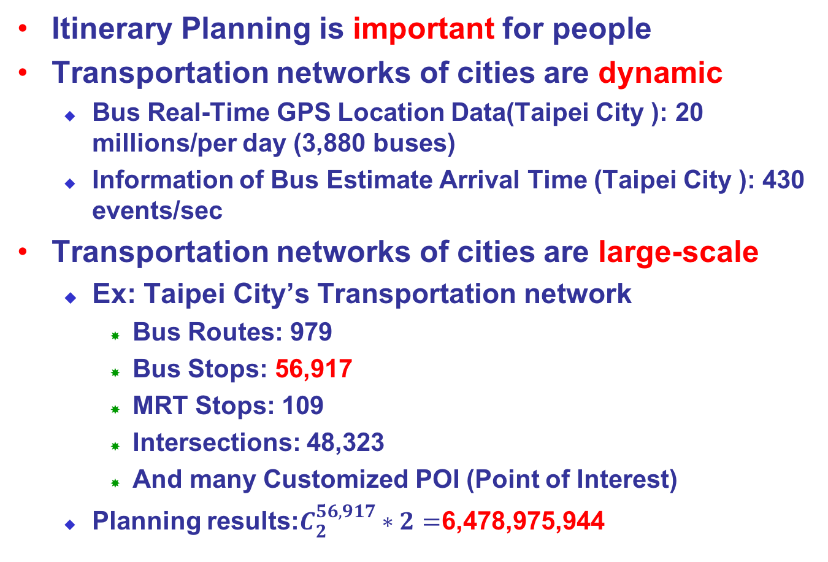
Introduction-Motivation (1/2)
Itinerary Planning is important for people
Transportation networks of cities are dynamic
Bus Real-Time GPS Location Data(Taipei City ): 20 millions/per day (3,880 buses)
Information of Bus Estimate Arrival Time (Taipei City ): 430 events/sec
Transportation networks of cities are large-scale
Ex: Taipei City’s Transportation network
Bus Routes: 979
Bus Stops: 56,917
MRT Stops: 109
Intersections: 48,323
And many Customized POI (Point of Interest)
Planning results:$C_{2}^{56,917}∗2=$6,478,975,944
Notes:
Pre Travel planning has always been important needs of people
----- 會議記錄 (2014/8/15 17:00) -----
增加-情境
基本目的強調
為何需要巨量分析
32000 公車站牌
十字路口
==
智慧型運輸系統
行前旅運規劃一直是重要的研究課題。
ITS係應用資訊、通信、電子、控制、運輸及管理等技術，改善既有運輸系統服務效率，優化用路人服務品質，並提昇用路安全與落實環境保護，以確保永續運輸發展之過程。
目的：提供有用、即時及動態的交通資訊，營造更智慧化、更便利的交通環境
Dr. T
使用Hadoop建置分散式巨量分析之旅運規劃系統，(Dr. T 運輸博士) 提供民眾及用路人整合及互動式旅運規劃交通資訊友善諮詢介面，將便利、有用、即時及動態之整合交通資訊提供給民眾，以利民眾行的便利。(T Language )
預估時間：
N1, StopID, RouteID, BusID, CurrentStop, DestinationStop, IsLastBus, EstimateTime, StopDistance, Direction
N1,39507,10848,222236718,39500,39515,0,599,7,0,2,140918201155,08173984,140918201155
A1,Cmp,BusID,DutyStatus,BusStatus,PathAttribueID,GoBack,X,Y,Speed,Azimuth,GPSTime
A1,800,222236672,1,0,108480,0,121.560699,25.058846,0.000000,261.059998,201447,1,140918201449,00051693,140918201449

Slide 4
Introduction-Motivation (2/2)
The thesis presents an itinerary planning advisor called Dr. T that provides
Dynamic：Provide Real-Time information
Demand-Responsive：Support interactive itinerary planning results
Notes:
Pre Travel planning has always been important needs of people
----- 會議記錄 (2014/8/15 17:00) -----
增加-情境
基本目的強調
為何需要巨量分析
32000 公車站牌
十字路口
==
智慧型運輸系統
行前旅運規劃一直是重要的研究課題。
ITS係應用資訊、通信、電子、控制、運輸及管理等技術，改善既有運輸系統服務效率，優化用路人服務品質，並提昇用路安全與落實環境保護，以確保永續運輸發展之過程。
目的：提供有用、即時及動態的交通資訊，營造更智慧化、更便利的交通環境
Dr. T
使用Hadoop建置分散式巨量分析之旅運規劃系統，(Dr. T 運輸博士) 提供民眾及用路人整合及互動式旅運規劃交通資訊友善諮詢介面，將便利、有用、即時及動態之整合交通資訊提供給民眾，以利民眾行的便利。(T Language )

Slide 5
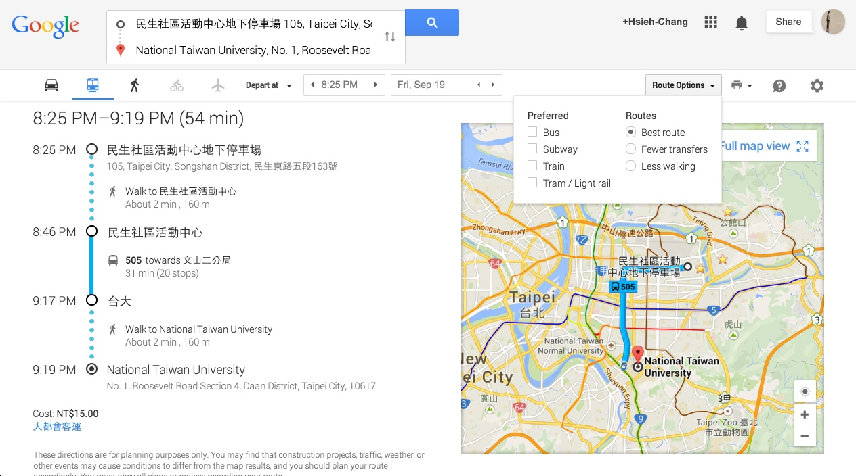
Related Work-Google(1/3)
User preferences(使用者偏好)
Modal Choice(運具選擇)
Departure/Arrive Time(出發/抵達時間)
Planning results(規劃結果)
Walking time(步行時間)
Travel Time(旅行時間)
Stop distance(站距)
Fare(票價)
Lack of dynamic information for Bus
Notes:
Global itinerary planning site: goolge Lack of dynamic information with itinerary planning

Slide 6
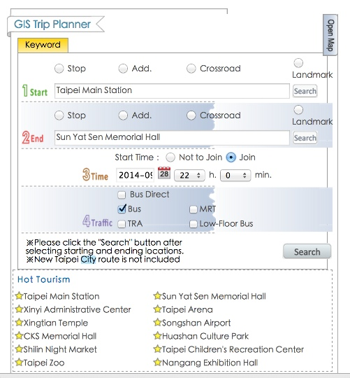
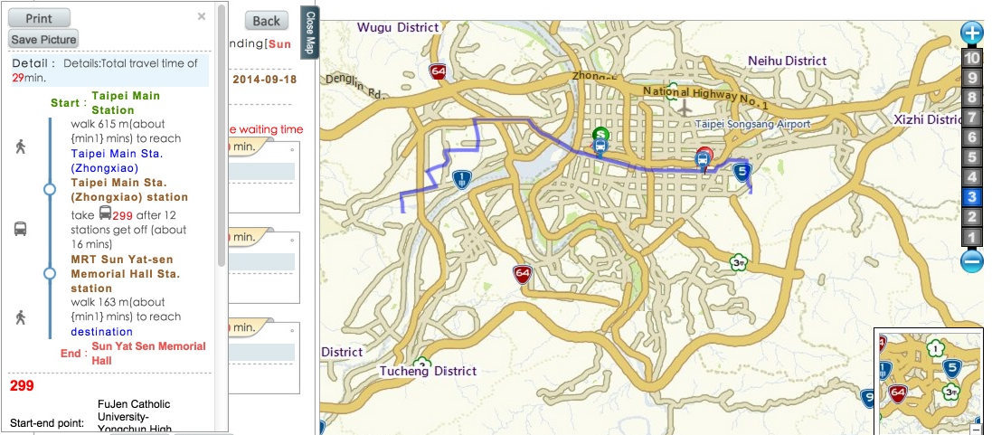
Related Work-Taipei E-bus (2/3)
User preferences(使用者偏好)
Modal Choice(運具選擇)
Departure Time(出發時間)
Planning results (規劃結果)
Walking time(步行時間)
Travel Time(旅行時間)
Stop distance(站距)
Lack of dynamic information for Bus

Slide 7
Related Work(3/3)
System Name |  |  | # of Results | Criteria | Modal Type | Timetable | Dynamic Info.
Global | 1 | Google | M | Ti,D,W,Tr | I,B,R,A,P | ○ | X
Asia | 2 | e-iot(交通部運研所) | M | Ti,Co,Tr | I,R,A,P | ○ | X
 | 3 | Taipei Bus Information and Transit System(北市公車) | M | D | B,S | X | X
 | 4 | Tainan City Tour Guide System(台南公車) | M | Tr,D,W | B | ○ | X
M=Multi-results(多方案)，S=Single result(單一方案) Tr=Fewer Transfers(最少轉乘)，D=Short Distance(最短距離),W=Less Walking(最少步行)，Co=Minimum fare(最少票價)，Ti=Most Fast(最快到達)，Wh=Accessibility Devices(無障礙設施) E=Itercity Bus(城際客運)，B=Bus(公車)，S=Subway(地鐵)，L=LRT(輕軌)，R=Rail(鐵路)，F=Ferry(渡輪)，P=Private Car(私人汽車)，A=air(航空) ○=Condiser(有考量)，X=Do not Consider(未考量)
Notes:
2 e-iot
http://e-iot.iot.gov.tw/
3.Taipei 5284
http://www.5284.com.tw/Dybus.aspx?Lang=En
4.台南觀光導遊系統
http://tourguide.tainan.gov.tw/tnbus/
5.香港城巴
http://www.nwstbus.com.hk/routesearch.aspx?t=1411047817620&intLangID=1
7. London
https://www.tfl.gov.uk/plan-a-journey/
8.TakeTransit Trip Planner
San Francisco Bay Area
http://tripplanner.transit.511.org/mtc/XSLT_TRIP_REQUEST2?language=en&itdLPxx_homepage=secondStep
9. OTCA 加洲(Orange County Transporttion Authority)
https://play.google.com/store/apps/details?id=org.busbrothers.anystop.orangecounty&hl=zh_TW
10 Metro Trip Planner (洛杉磯)
http://socaltransport.org/tm_pub_start.php
11 RTD Regional Transportation District (denver)
http://www.rtd-denver.com/GoogleTripPlanner.shtml
14
Twin Cities Public Transit-
http://en.wikipedia.org/wiki/Metro_Transit_(Minnesota)
https://www.metrotransit.org/imap/map.aspx
雙城-聖路易及明尼亞波里
https://tw.knowledge.yahoo.com/question/question?qid=1405122305433
Minneapolis( and St. Paul, Minnesota transit information.
15
USA-UTA The Uath Transir Authority http://www.rideuta.com/mc/?page=TripPlanner
16
瑞士聯邦鐵路 Schweizerische Bundesbahnen SBB http://www.sbb.ch/en/home.html

Slide 8





Problem Description-Definition(1/4)
Plan B:Bus transfer to MRT
Origin
Plan A:Bus Direct
Route 225/R31
Route 505
Legend
MRT Station
Bus Stop
Walkway
Destination
Notes:
https://www.google.com.tw/maps/dir/%E8%87%BA%E7%81%A3%E5%A4%A7%E5%AD%B8+10617%E5%8F%B0%E5%8C%97%E5%B8%82%E5%A4%A7%E5%AE%89%E5%8D%80%E7%BE%85%E6%96%AF%E7%A6%8F%E8%B7%AF%E5%9B%9B%E6%AE%B51%E8%99%9F/No.+456,+F%C3%B9j%C7%90n+St,+Songshan+District,+Taipei+City,+Taiwan/@25.0408448,121.5387203,14z/data=!4m14!4m13!1m5!1m1!1s0x3442a989fe322ea9:0x21750404ee1d7f66!2m2!1d121.539752!2d25.017341!1m5!1m1!1s0x3442ab8d05f16781:0x6542056b10734fe!2m2!1d121.5622793!2d25.0606963!3e3

Slide 9
Problem Description-Definition(2/4)
Destination(t)
walk
Travel Plan
Start Stop
End Stop
walk
Walk Distance : Wd
Number of Transfer < Tr
Origin(s)

Slide 10
Problem Description(3/4)
Subject：Research on Dynamic Itinerary Planning System
Input
Origin： (Longitude,Latitude)(WGS84)
Destination：(Longitude,Latitude)(WGS84)
User Preferences
Modal type(Bus or MRT)
Dynamic information for bus location
Objective: Min. Total Travel Time
Output
Travel planning result
Travel time
Stop distance
Provide the Real-Time Bus Arrival Time Info.

Slide 11
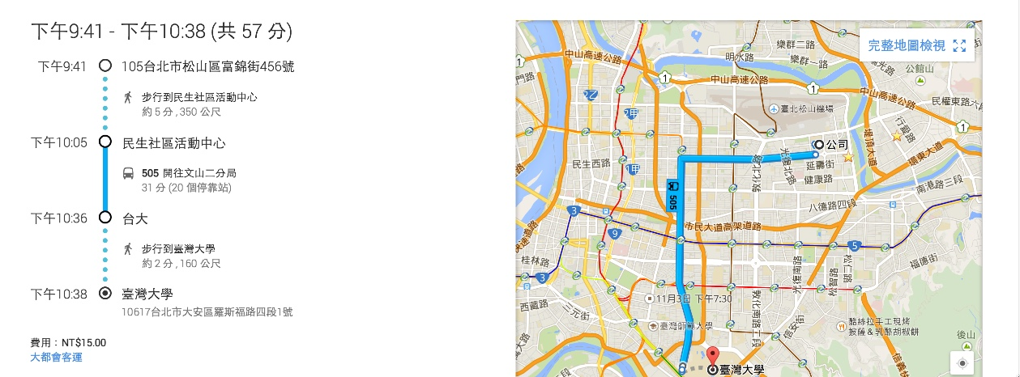
Problem Description-Output w/ dynamic info.(4/4)
22:05到站(Arrive)

Slide 12
Methodology
1.Dijkstra’s shortest path Algorithm
2.BSP(Bulk Synchronous Parallel)-Pregel
Notes:
Pregel: A System for Large-Scale Graph Processing
http://www.slideshare.net/shatteredNirvana/pregel-a-system-for-largescale-graph-processing
BSP(Bulk Synchronous Parallel)-分散演算-Pregel: A System for Large-Scale Graph Processing

Slide 13
Methodology-The Basic Graph Model
Graph model G=(V,E)
Each node in V represents a stop
directed edges e=(u,v) that connects two consecutive stops u and v along the route
label the edge e with its service line => multiple labeled edges
graph G is a multi-graph in which between any pair of nodes u and v
u
e =(u,v)
v

Slide 14
Methodology-Modeling Walking Edges
Model walking between “nearby” stops
Two directed edges e1=(u,v) and e2=(v,u) between two nodes u and v in the graph whenever the two stops corresponding to u and v are “within walking distance” of each other
a source point s that is not a stop in V
add the walking edge e=(s,u)
a destination point t that is not a stop in V
add the walking edge e=(v,t)
Destination(t)
walk
Start Stop(u)
End Stop(v)
walk
Origin(s)

Slide 15
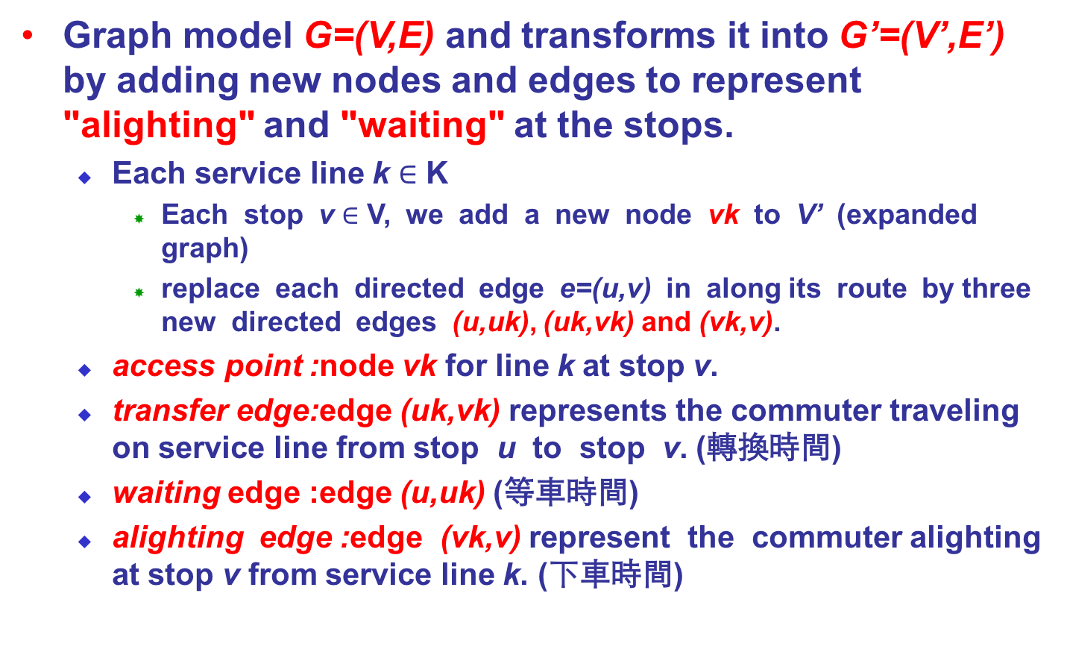
Methodology-Model Transfer between Modes
Graph model G=(V,E) and transforms it into G’=(V’,E’) by adding new nodes and edges to represent "alighting" and "waiting" at the stops.
Each service line k $∈$ K
Each stop v $∈$ V, we add a new node vk to V’ (expanded graph)
replace each directed edge e=(u,v) in along its route by three new directed edges (u,uk), (uk,vk) and (vk,v).
access point :node vk for line k at stop v.
transfer edge:edge (uk,vk) represents the commuter traveling on service line from stop u to stop v. (轉換時間)
waiting edge :edge (u,uk) (等車時間)
alighting edge :edge (vk,v) represent the commuter alighting at stop v from service line k. (下車時間)

Slide 16
Methodology-Model Transfer between Modes
m1:Bus or MRT
G=(V,E)
m2:Bus or MRT
Mode m1 transfer to Mode m2
T’
Stop(u’)
walking edge
Stop(v’)
Stop(u)
Stop(v)
T
T
c
Stop(uk)
Transfer Stop(t)
Mode m2
Mode m1
Type A: the same location
Walking cost Wwt=0
Waiting cost = the waiting time for next Bus/MRT depends on mode m2 schedule
Type B: different stop within allow walking distance
Walking cost Wwt= the walking time from T to T’
Waiting cost = the waiting time for next Bus/MRT depends on mode m2 schedule
Notes:
Node Explosion Transformation by Spiess and Florian,1989

Slide 17
Methodology-Dynamic Transfers and Min. Travel Time
For each edge e in the graph G’=(V’,E’), we assign a travel time weight wtt(e) to denote the time taken to travel along edge e.
For a traveling edge e=(u,v), wtt(e) is the time taken to travel from stop u to stop v.
For an alighting edge e=(vh,v), wt(e) = 0 (negligible).
For a waiting edge e=(v,vk), wwt(e) represents the waiting time between arriving at stop v and boarding the service line k.
The waiting time wwt(e) is dynamic

Slide 18
Methodology-Min. the Total Travel Time
Graph model G=(V,E)
Wt(euv) denote the travel time from u to v along the labeled route
Min. Total Travel Time
applied on G to compute a s-to-t path that minimizes the total time
Min. Wt(esu) + Wt(eui) + … + Wt(eiv) +Wt(evt)
i: the any node between the u in V and v in V along the optional u-to-v path
Destination(t)
walk
Wt(eui)
… …
Wt(eiv)
Start Stop(u)
Intermediate Stop(i)
End Stop(v)
Wt(evt)
walk
Wt(esu)
Origin(s)
18

Slide 19
What is Dijkstra’s algorithm(1/3)?
Algorithm conceived by Edsger Dijkstra in 1956 and published in 1959
Dijkstra's algorithm : an optimal greedy algorithm to find the minimum distance and shortest path in a weighted graph from a given start node.
Dijkstra's algorithm : is a solution to the single-source shortest path problem in graph theory.
Works on both directed and undirected graphs. However, all edges must have non-negative weights.
Input: Weighted graph G={E,V} and source vertex v∈V, such that all edge weights are nonnegative
Output: Lengths of shortest paths (or the shortest paths themselves) from a given source vertex v∈V to all other vertices
Notes:
http://en.wikipedia.org/wiki/Dijkstra's_algorithm

Slide 20
Dijkstra’s algorithm-Psudo Code(2/3)?
dist[s] ←0 (distance to source vertex is zero) for all v ∈ V–{s} do dist[v] ←∞ (set all other distances to infinity) S←∅ (S, the set of visited vertices is initially empty) Q←V (Q, the queue initially contains all vertices) while Q ≠∅ (while the queue is not empty) do u ← mindistance(Q,dist) (select the element of Q with the min. dist. ) S←S∪{u} (add u to list of visited vertices) for all v ∈ neighbors[u] do if dist[v] > dist[u] + w(u, v) (if new shortest path found) then d[v] ←d[u] + w(u, v) (set new value of shortest path)
(if desired, add traceback code)
return dist
Notes:
http://en.wikipedia.org/wiki/Dijkstra's_algorithm

Slide 21
Dijkstra’s algorithm-Pregel-Scala Code(3/3)?
val sourceId: VertexId = 0 // The ultimate source
// Initialize the graph such that all vertices except the root have distance infinity.
val initialGraph: Graph[(Double, List[VertexId]), Double] = graph.mapVertices((id, _) => if (id == sourceId) (0.0, List[VertexId](sourceId)) else (Double.PositiveInfinity, List[VertexId]()))
val sssp = initialGraph.pregel((Double.PositiveInfinity, List[VertexId]()), Int.MaxValue, EdgeDirection.Out)(
// Vertex Program(calculate each vertex)
(id, dist, newDist) => if (dist._1 < newDist._1) dist else newDist,
// Send Message
triplet => {
if (triplet.srcAttr._1 < triplet.dstAttr._1 - triplet.attr) {
Iterator((triplet.dstId, (triplet.srcAttr._1 + triplet.attr, triplet.srcAttr._2 :+ triplet.dstId)))
} else {
Iterator.empty
}
},
//Merge Message
(a, b) => if (a._1 < b._1) a else b)
Notes:
http://en.wikipedia.org/wiki/Dijkstra's_algorithm

Slide 22
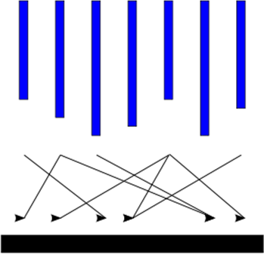
Methodology-Pregel
Pregel is a model suitable for large-scale graph computing with a production-quality, scalable and fault tolerant implementation.
Input
Supersteps
(a sequence of iterations)
Output
Notes:
Pre Travel planning has always been important needs of people
----- 會議記錄 (2014/8/15 17:00) -----
增加-情境
基本目的強調
為何需要巨量分析
32000 公車站牌
十字路口
==
智慧型運輸系統
行前旅運規劃一直是重要的研究課題。
ITS係應用資訊、通信、電子、控制、運輸及管理等技術，改善既有運輸系統服務效率，優化用路人服務品質，並提昇用路安全與落實環境保護，以確保永續運輸發展之過程。
目的：提供有用、即時及動態的交通資訊，營造更智慧化、更便利的交通環境
Dr. T
使用Hadoop建置分散式巨量分析之旅運規劃系統，(Dr. T 運輸博士) 提供民眾及用路人整合及互動式旅運規劃交通資訊友善諮詢介面，將便利、有用、即時及動態之整合交通資訊提供給民眾，以利民眾行的便利。(T Language )
預估時間：
N1, StopID, RouteID, BusID, CurrentStop, DestinationStop, IsLastBus, EstimateTime, StopDistance, Direction
N1,39507,10848,222236718,39500,39515,0,599,7,0,2,140918201155,08173984,140918201155
A1,Cmp,BusID,DutyStatus,BusStatus,PathAttribueID,GoBack,X,Y,Speed,Azimuth,GPSTime
A1,800,222236672,1,0,108480,0,121.560699,25.058846,0.000000,261.059998,201447,1,140918201449,00051693,140918201449

Slide 23
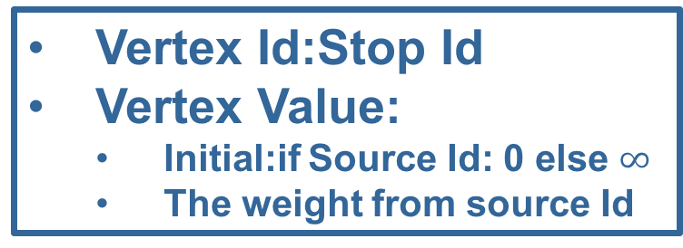
Methodology-Model of Computation (Vertex)
c
Vertex
Id
Edge Value
Vertex Id
c
Edge Value
Vertex Id
Vertex Value
Vertex Id:Stop Id
Vertex Value:
Initial:if Source Id: 0 else $∞$
The weight from source Id
Edge Value:travel time
weight

Slide 24
Methodology-Model of Computation (Vertex Actions)
A vertex can:
Modify its values
Receive messages from
previous superstep
Send messages
Request topology changes
Vertex Id
Vertex Value

Slide 25
Example: SSSP – Parallel BFS in Pregel
∞
∞
1
10
0
2
3
9
4
6
5
7
∞
∞
2
Notes:
傳統SSSp vs pregel
http://www.slideshare.net/binzhao/2010pregel
http://www.slideshare.net/WeiruDai/pregel-27339969

Slide 26
Example: SSSP – Parallel BFS in Pregel
∞
∞
1
10
0
2
3
9
4
6
5
7
∞
∞
2
Notes:
http://www.slideshare.net/WeiruDai/pregel-27339969

Slide 27
Example: SSSP – Parallel BFS in Pregel
∞
∞
∞
1
10
10
∞
∞
∞
0
∞
2
3
9
4
6
5
∞
7
∞
5
∞
∞
2
∞

Slide 28
Example: SSSP – Parallel BFS in Pregel
10
∞
1
10
0
2
3
9
4
6
5
7
5
∞
2

Slide 29
Example: SSSP – Parallel BFS in Pregel
10
11
∞
1
14
10
8
0
2
3
9
4
6
5
12
7
5
∞
2
7

Slide 30
Example: SSSP – Parallel BFS in Pregel
8
11
1
10
0
2
3
9
4
6
5
7
5
7
2

Slide 31
Example: SSSP – Parallel BFS in Pregel
8
9
11
1
10
13
0
14
2
3
9
4
6
5
7
15
5
7
2

Slide 32
Example: SSSP – Parallel BFS in Pregel
8
9
1
10
0
2
3
9
4
6
5
7
5
7
2

Slide 33
Example: SSSP – Parallel BFS in Pregel
8
9
1
10
0
2
3
9
4
6
5
7
13
5
7
2

Slide 34
Example: SSSP – Parallel BFS in Pregel
8
9
1
10
0
2
3
9
4
6
5
7
5
7
2

Slide 35
Implementation
This is my thesis Implementation
Notes:
Pre Travel planning has always been important needs of people
----- 會議記錄 (2014/8/15 17:00) -----
增加-情境
基本目的強調
為何需要巨量分析
32000 公車站牌
十字路口
==
智慧型運輸系統
行前旅運規劃一直是重要的研究課題。
ITS係應用資訊、通信、電子、控制、運輸及管理等技術，改善既有運輸系統服務效率，優化用路人服務品質，並提昇用路安全與落實環境保護，以確保永續運輸發展之過程。
目的：提供有用、即時及動態的交通資訊，營造更智慧化、更便利的交通環境
Dr. T
使用Hadoop建置分散式巨量分析之旅運規劃系統，(Dr. T 運輸博士) 提供民眾及用路人整合及互動式旅運規劃交通資訊友善諮詢介面，將便利、有用、即時及動態之整合交通資訊提供給民眾，以利民眾行的便利。(T Language )
預估時間：
N1, StopID, RouteID, BusID, CurrentStop, DestinationStop, IsLastBus, EstimateTime, StopDistance, Direction
N1,39507,10848,222236718,39500,39515,0,599,7,0,2,140918201155,08173984,140918201155
A1,Cmp,BusID,DutyStatus,BusStatus,PathAttribueID,GoBack,X,Y,Speed,Azimuth,GPSTime
A1,800,222236672,1,0,108480,0,121.560699,25.058846,0.000000,261.059998,201447,1,140918201449,00051693,140918201449

Slide 36
Dr.T System Framework
Static Info.
Route Info
UI
Stop Info
DB
HTTP
Parser
Planner
Publisher
Time Cost
Time from StopA to StopB
Adapter
Updater
Adviser
Dynamic Info.
Bus Estimate Arrival Time
Socket
Memory
Dr.T：an itinerary planning advisor

Slide 37
Algorithm Flow with dynamic info.
Start
Calculate the time
from Origin to the node of O{}
User set
Origin and Dest.
Calculate the time
from Dest. to the node of D{}
Search the nearest
Nodes for all modes
Origin => O{}
Dest. => D{}
Calculate the total time
And update the realtime info
O{}=Φ
Yes
No any node
for Origin
Feasible
solution
FR{}
No
D{}=Φ
FR{}=Φ
Yes
No any node
for Dest.
No
Sort by time
desc
Output
End
Yes

Slide 38
Data Design
T-Vertex(運輸節點)
Id
Desc.
39506
39507
39508
39511
Attribute (V)
([Mode], [Name],Location[Lon,Lat],LastTTE)
([Bus], B1,[121.534155, 25.021653],300)
([Bus], B2,[121.533507, 25.01843],360)
([Bus,MRT], [B3,M2],[121.534778, 25.014573],[540,10])
([Bus,MRT], M1,[121.539077, 25.001755],300)
Bus 505
臺大綜合體育館
臺大
B2
B1
Bus 505/MRT
捷運公館站
B3M2
M1
T-Edge(運輸路徑)
SrcId | DstId
B1 | B2
B2 | B3
M1 | M2
M2 | M3
Attribute (E)
60
180
300
180
捷運萬隆站
捷運台電大樓站
M3

Slide 39
Implementation-T-Vertex-Id coding rule
Vertex Id coding rule
[A]-[BB]-[CCC]-[DDDDD]-[EEEE]-[F]
Vertex Id
[A] | Land:1 Sea:2 Air:3
[BB] | Bus:00 MRT:01 …
[CCC] | Country Code
[DDDDD] | ZipCode
[EEEE] | Sequence
[F] | Direction
Vertex Id
Vertex Value
Vertex Type
Notes:
Pre Travel planning has always been important needs of people
----- 會議記錄 (2014/8/15 17:00) -----
增加-情境
基本目的強調
為何需要巨量分析
32000 公車站牌
十字路口
==
智慧型運輸系統
行前旅運規劃一直是重要的研究課題。
ITS係應用資訊、通信、電子、控制、運輸及管理等技術，改善既有運輸系統服務效率，優化用路人服務品質，並提昇用路安全與落實環境保護，以確保永續運輸發展之過程。
目的：提供有用、即時及動態的交通資訊，營造更智慧化、更便利的交通環境
Dr. T
使用Hadoop建置分散式巨量分析之旅運規劃系統，(Dr. T 運輸博士) 提供民眾及用路人整合及互動式旅運規劃交通資訊友善諮詢介面，將便利、有用、即時及動態之整合交通資訊提供給民眾，以利民眾行的便利。(T Language )
預估時間：
N1, StopID, RouteID, BusID, CurrentStop, DestinationStop, IsLastBus, EstimateTime, StopDistance, Direction
N1,39507,10848,222236718,39500,39515,0,599,7,0,2,140918201155,08173984,140918201155
A1,Cmp,BusID,DutyStatus,BusStatus,PathAttribueID,GoBack,X,Y,Speed,Azimuth,GPSTime
A1,800,222236672,1,0,108480,0,121.560699,25.058846,0.000000,261.059998,201447,1,140918201449,00051693,140918201449

Slide 40
Implementation-T-Vertex
)
Vertex Value = Travel Time from the Source VertexId
Vertex Id
Vertex Value
Vertex Type
Notes:
Pre Travel planning has always been important needs of people
----- 會議記錄 (2014/8/15 17:00) -----
增加-情境
基本目的強調
為何需要巨量分析
32000 公車站牌
十字路口
==
智慧型運輸系統
行前旅運規劃一直是重要的研究課題。
ITS係應用資訊、通信、電子、控制、運輸及管理等技術，改善既有運輸系統服務效率，優化用路人服務品質，並提昇用路安全與落實環境保護，以確保永續運輸發展之過程。
目的：提供有用、即時及動態的交通資訊，營造更智慧化、更便利的交通環境
Dr. T
使用Hadoop建置分散式巨量分析之旅運規劃系統，(Dr. T 運輸博士) 提供民眾及用路人整合及互動式旅運規劃交通資訊友善諮詢介面，將便利、有用、即時及動態之整合交通資訊提供給民眾，以利民眾行的便利。(T Language )
預估時間：
N1, StopID, RouteID, BusID, CurrentStop, DestinationStop, IsLastBus, EstimateTime, StopDistance, Direction
N1,39507,10848,222236718,39500,39515,0,599,7,0,2,140918201155,08173984,140918201155
A1,Cmp,BusID,DutyStatus,BusStatus,PathAttribueID,GoBack,X,Y,Speed,Azimuth,GPSTime
A1,800,222236672,1,0,108480,0,121.560699,25.058846,0.000000,261.059998,201447,1,140918201449,00051693,140918201449

Slide 41
Implementation-T-Vertex
Vertex Type Attribute (V)
[Mode] | Bus
[Name] | 民生社區活動中心
Location[Lon,Lat] | (121.5613867, 25.05884333)
[Route] | 612區
Scheduld List | 0610 0630 0650 1600 1620 1640
LastTTE | 600(sec)
CarArrivalList | [(100-AD,600),(200-AD,1200]
Vertex Id
static
Vertex Value
Vertex Type
dynamic
Notes:
Pre Travel planning has always been important needs of people
----- 會議記錄 (2014/8/15 17:00) -----
增加-情境
基本目的強調
為何需要巨量分析
32000 公車站牌
十字路口
==
智慧型運輸系統
行前旅運規劃一直是重要的研究課題。
ITS係應用資訊、通信、電子、控制、運輸及管理等技術，改善既有運輸系統服務效率，優化用路人服務品質，並提昇用路安全與落實環境保護，以確保永續運輸發展之過程。
目的：提供有用、即時及動態的交通資訊，營造更智慧化、更便利的交通環境
Dr. T
使用Hadoop建置分散式巨量分析之旅運規劃系統，(Dr. T 運輸博士) 提供民眾及用路人整合及互動式旅運規劃交通資訊友善諮詢介面，將便利、有用、即時及動態之整合交通資訊提供給民眾，以利民眾行的便利。(T Language )
預估時間：
N1, StopID, RouteID, BusID, CurrentStop, DestinationStop, IsLastBus, EstimateTime, StopDistance, Direction
N1,39507,10848,222236718,39500,39515,0,599,7,0,2,140918201155,08173984,140918201155
A1,Cmp,BusID,DutyStatus,BusStatus,PathAttribueID,GoBack,X,Y,Speed,Azimuth,GPSTime
A1,800,222236672,1,0,108480,0,121.560699,25.058846,0.000000,261.059998,201447,1,140918201449,00051693,140918201449

Slide 42
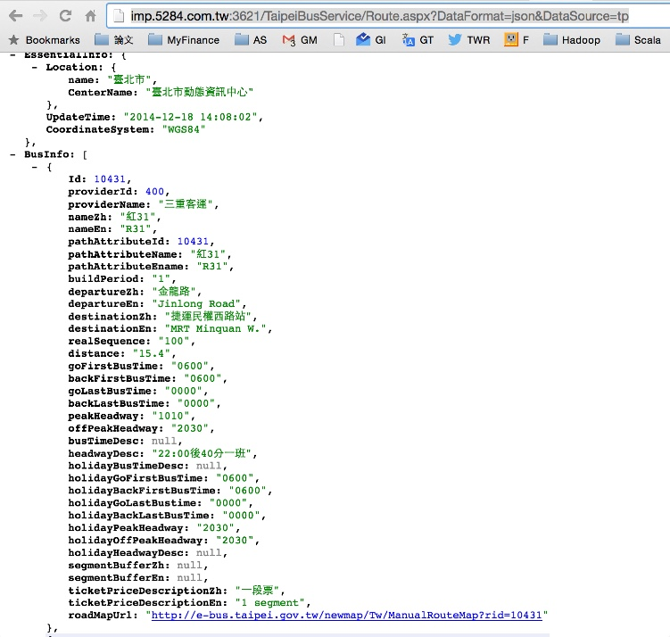
Static info.-Route Info
Route.aspx | 路線
屬性 | 說明
Id | 路線代碼
providerId | 業者代碼
providerName | 業者中文名稱
nameZh | 中文名稱
nameEn | 英文名稱
pathAttributeId | 所屬附屬路線ID
pathAttributeName | 所屬附屬路線中文名稱
pathAttributeEname | 所屬附屬路線英文名稱
buildPeriod | 建置時間，分為1：1期、2：2期、3：3期、9：非動態資料、10：北縣
departureZh | '去程第1站' 起站中文名稱
departureEn | '去程第1站' 起站英文名稱
destinationZh | '回程第1站' 訖站中文名稱
destinationEn | '回程第1站' 訖站英文名稱
realSequence | 核定總班次
distance | 總往返里程(公里/全程)
goFirstBusTime | 站牌顯示時使用，去程第一班發車時間(hhmm)
backFirstBusTime | 站牌顯示時使用，回程第一班發車時間(hhmm)
goLastBusTime | 站牌顯示時使用，去程最後一班發車時間(hhmm)
backLastBusTime | 站牌顯示時使用，回程最後一班發車時間(hhmm)
peakHeadway | 站牌顯示時使用，尖峰時段發車間隔(hhmm OR mm)
offPeakHeadway | 站牌顯示時使用，離峰時段發車間隔(hhmm OR mm)
busTimeDesc | 平日頭末班描述
holidayGoFirstBusTime | 假日站牌顯示時使用，去程第一班發車時間(HHmm)
holidayBackFirstBusTime | 假日站牌顯示時使用，回程第一班發車時間(HHmm)
holidayGoLastBusTime | 假日站牌顯示時使用，去程最後一班發車時間(HHmm)
holidayBackLastBusTime | 假日站牌顯示時使用，回程最後一班發車時間(HHmm)
holidayBusTimeDesc | 假日頭末班描述
headwayDesc | 平日發車間距描述
holidayPeakHeadway | 假日站牌顯示時使用，尖峰時段發車間隔(mmmm OR mm)
holidayOffPeakHeadway | 假日站牌顯示時使用，離峰時段發車間隔(mmmm OR mm)
holidayHeadwayDesc | 假日發車間距描述
segmentBufferZh | 分段緩衝區(中文)
segmentBufferEn | 分段緩衝區(英文)
ticketPriceDescriptionZh | 票價描述(中文)
ticketPriceDescriptionEn | 票價描述(英文)
Route roadMapUrl | 路線圖URL
JSON Format
Notes:
http://imp.5284.com.tw:3621/TaipeiBusService/Route.aspx?DataFormat=json&DataSource=tp

Slide 43
Static info.-Stop Info
Stop.aspx | 站牌
屬性 | 說明
Id | 站牌代碼
routeId | 所屬路線代碼 (主路線ID)
nameZh | 中文名稱
nameEn | 英文名稱
seqNo | 於路線上的順序
pgp | 上下車站別 （-1：可下車、0：可上下車、1：可上車）
goBack | 去返程 （0：去程 / 1：返程 / 2：未知）
longitude | 經度
latitude | 緯度
address | 地址
stopLocationId | 站位ID
showLon | 顯示用經度
showLat | 顯示用緯度
vector | 向量角：0~359，預設為空白
JSON Format

Slide 44
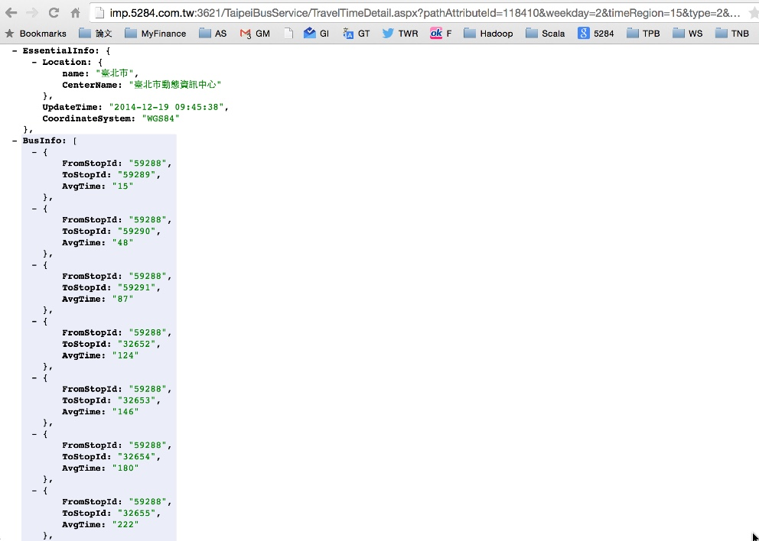
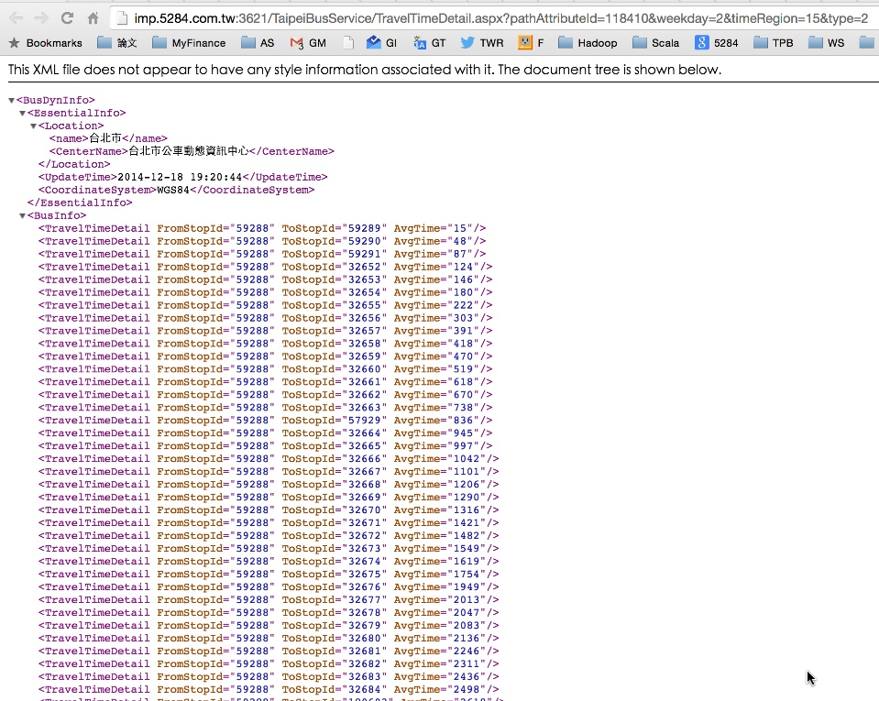
Static info.-Time Cost Info
TravelTimeDetail.aspx | 歷史旅行時間
屬性 | 說明
FromStopId | 起站id
ToStopId | 迄站id
AvgTime | 平均時間
附注 此表特有參數 (大小寫需一致，需帶參數) pathAttributeId：為附屬路線代碼 weekday：為星期，值為1~7：1：星期日，2：星期一，7：星期六 timeRegion：為時區(分24個維度：0~1, 1~2, …) 0：表示00：00~01：00， 23：表示23：00~24：00 type：1：站和站之間旅行時間，2 自首站累加（預設） 範例： http://imp.5284.com.tw:3621/TaipeiBusService/TravelTimeDetail.aspx?pathAttributeId=118410&weekday=2&timeRegion=15&type=2&DataFormat=json
JSON Format
XML Format

Slide 45
Dynamic info.-Bus Estimate Arrival Time
Socket
訊息編號 | N1 | 訊息型態 | 設定
目的 | 更新站牌即時公車資訊
用途 | 控制中心下載即時公車資訊至站牌
訊息格式 | N1, StopID, RouteID, BusID, CurrentStop, DestinationStop, IsLastBus, EstimateTime, StopDistance, Direction,Type,TransTime,S/N,RecTime
範例 | N1, 350301412471557,285, 10000008, 350301412471560, 350301412471600,1, 5,3,1,1, 090203143750, 00000001, 090203143751
訊 息 參 數 定 義 | N1：訊息代碼 StopID（String）：站牌代碼(StopId站牌編號) RouteID（String）：路線代碼(PathId主路線編號) BusID（String）：車輛代碼(-1代表路線上查詢站牌前無車) (CarId車輛編號) CurrentStop（String）：車輛目前所在站牌代碼(-1表班表機制無車時，無此站牌) (StopId站牌編號) DestinationStop（String）：車輛目的站牌代碼(-1表班表機制無車時，無此站牌) (StopId站牌編號) IsLastBus（String）：車輛是否末班車(1->末班車 0->非末班車) EstimateTime（String）：車輛抵達StopID的預估到站時間（分）(秒) -1 尚未發車 -2 交管不停靠 -3 末班車已過 -4 今日未營運 StopDistance（String）：車輛距離本站站數 Direction（String）：方向(0：去程 1：返程) Type：本訊息種類(1：定期, 2：非定期) TrasTime：傳出時間，發送時間格式為：090203143750,年-月-日-時-分-秒 S/N： 發送序號：00000001,年-月-日-流水號(8)。 RecTime：接收到的時間，格式為：090203143750,年-月-日-時-分-秒

Slide 46
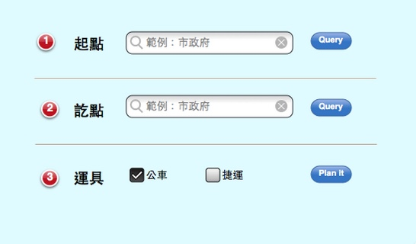
Dr.T UI Design

Slide 47
Implementation-Partition Strategy
)
Partition Strategy
RandomVertexCut | Assigns edges to partitions by hashing the source and destination vertex IDs(the same direction)
CanonicalRandomVertexCut | Assigns edges to partitions by hashing the source and destination vertex IDs in a canonical direction
EdgePartition1D | Assigns edges to partitions using only the source vertex ID, colocating edges with the same source.
EdgePartition2D | Assigns edges to partitions using a 2D partitioning of the sparse edge adjacency matrix
Notes:
Source:
https://github.com/apache/spark/blob/master/graphx/src/main/scala/org/apache/spark/graphx/PartitionStrategy.scala

Slide 48
Implementation Results
route:1188
Stop:58308
TravelTime weight:7,469,454
TravelTime weight:64,182,120
Test Environment
Notebook | MacBook Pro(Retina)
CPU | 2.6 GHz Intel Core i5 (1 CPU/4Cores)
RAM | 16 GB 1600 MHz DDR3
Notes:
Pre Travel planning has always been important needs of people
----- 會議記錄 (2014/8/15 17:00) -----
增加-情境
基本目的強調
為何需要巨量分析
32000 公車站牌
十字路口
==
智慧型運輸系統
行前旅運規劃一直是重要的研究課題。
ITS係應用資訊、通信、電子、控制、運輸及管理等技術，改善既有運輸系統服務效率，優化用路人服務品質，並提昇用路安全與落實環境保護，以確保永續運輸發展之過程。
目的：提供有用、即時及動態的交通資訊，營造更智慧化、更便利的交通環境
Dr. T
使用Hadoop建置分散式巨量分析之旅運規劃系統，(Dr. T 運輸博士) 提供民眾及用路人整合及互動式旅運規劃交通資訊友善諮詢介面，將便利、有用、即時及動態之整合交通資訊提供給民眾，以利民眾行的便利。(T Language )
預估時間：
N1, StopID, RouteID, BusID, CurrentStop, DestinationStop, IsLastBus, EstimateTime, StopDistance, Direction
N1,39507,10848,222236718,39500,39515,0,599,7,0,2,140918201155,08173984,140918201155
A1,Cmp,BusID,DutyStatus,BusStatus,PathAttribueID,GoBack,X,Y,Speed,Azimuth,GPSTime
A1,800,222236672,1,0,108480,0,121.560699,25.058846,0.000000,261.059998,201447,1,140918201449,00051693,140918201449

Slide 49
Evaluation
This is my thesis evaluation/validation
Test Results
node num | build graph time (milliseconds) | sssp/per node (milliseconds) | Sssp for all node(secs) | Sssp for all node(mins)
10000 | 143 | 5474 | 54740 | 912.33
20000 | 274 | 7931 | 158620 | 2643.67
30000 | 162 | 12021 | 360630 | 6010.50
40000 | 175 | 12939 | 517560 | 8626.00
50000 | 176 | 14522 | 726100 | 12101.67
60000 | 162 | 21144 | 1268640 | 21144.00
Notes:
Pre Travel planning has always been important needs of people
----- 會議記錄 (2014/8/15 17:00) -----
增加-情境
基本目的強調
為何需要巨量分析
32000 公車站牌
十字路口
==
智慧型運輸系統
行前旅運規劃一直是重要的研究課題。
ITS係應用資訊、通信、電子、控制、運輸及管理等技術，改善既有運輸系統服務效率，優化用路人服務品質，並提昇用路安全與落實環境保護，以確保永續運輸發展之過程。
目的：提供有用、即時及動態的交通資訊，營造更智慧化、更便利的交通環境
Dr. T
使用Hadoop建置分散式巨量分析之旅運規劃系統，(Dr. T 運輸博士) 提供民眾及用路人整合及互動式旅運規劃交通資訊友善諮詢介面，將便利、有用、即時及動態之整合交通資訊提供給民眾，以利民眾行的便利。(T Language )
預估時間：
N1, StopID, RouteID, BusID, CurrentStop, DestinationStop, IsLastBus, EstimateTime, StopDistance, Direction
N1,39507,10848,222236718,39500,39515,0,599,7,0,2,140918201155,08173984,140918201155
A1,Cmp,BusID,DutyStatus,BusStatus,PathAttribueID,GoBack,X,Y,Speed,Azimuth,GPSTime
A1,800,222236672,1,0,108480,0,121.560699,25.058846,0.000000,261.059998,201447,1,140918201449,00051693,140918201449

Slide 50
Evaluation
This is my thesis evaluation/validation
Notes:
Pre Travel planning has always been important needs of people
----- 會議記錄 (2014/8/15 17:00) -----
增加-情境
基本目的強調
為何需要巨量分析
32000 公車站牌
十字路口
==
智慧型運輸系統
行前旅運規劃一直是重要的研究課題。
ITS係應用資訊、通信、電子、控制、運輸及管理等技術，改善既有運輸系統服務效率，優化用路人服務品質，並提昇用路安全與落實環境保護，以確保永續運輸發展之過程。
目的：提供有用、即時及動態的交通資訊，營造更智慧化、更便利的交通環境
Dr. T
使用Hadoop建置分散式巨量分析之旅運規劃系統，(Dr. T 運輸博士) 提供民眾及用路人整合及互動式旅運規劃交通資訊友善諮詢介面，將便利、有用、即時及動態之整合交通資訊提供給民眾，以利民眾行的便利。(T Language )
預估時間：
N1, StopID, RouteID, BusID, CurrentStop, DestinationStop, IsLastBus, EstimateTime, StopDistance, Direction
N1,39507,10848,222236718,39500,39515,0,599,7,0,2,140918201155,08173984,140918201155
A1,Cmp,BusID,DutyStatus,BusStatus,PathAttribueID,GoBack,X,Y,Speed,Azimuth,GPSTime
A1,800,222236672,1,0,108480,0,121.560699,25.058846,0.000000,261.059998,201447,1,140918201449,00051693,140918201449

Slide 51
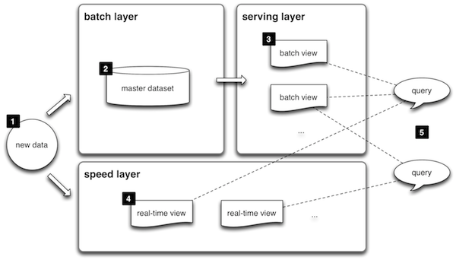

Evaluation-Spark for Analysis Engine
Spark:Apache Spark is a fast and general-purpose cluster computing system that developed by the AMPLab at UC Berkeley.
Why spark:
Fast :Spark is an in-memory data-processing framework
a framework support speed and batch processing
Iterative Algorithms
Relational Queries
MapReduce
Stream Processing
jolt
Notes:
Why spark https://gigaom.com/2014/06/28/4-reasons-why-spark-could-jolt-hadoop-into-hyperdrive/
Memory is cheap
http://www.jcmit.com/mem2015.htm

Slide 52

Evaluation-Mesos for Resource management
Mesos:a cluster manager that provides efficient resource isolation and sharing across distributed applications or frameworks.

Slide 53
Evaluation-implement environment
Master
Notebook | MacBook Pro(Retina)
CPU | 2.6 GHz Intel Core i5 (1 CPU/4Cores)
RAM | 16 GB 1600 MHz DDR3
Slave
Notebook | MacBook Pro(Retina)
CPU | 2.6 GHz Intel Core i5 (1 CPU/4Cores)
RAM | 8 GB 1600 MHz DDR3

Slide 54
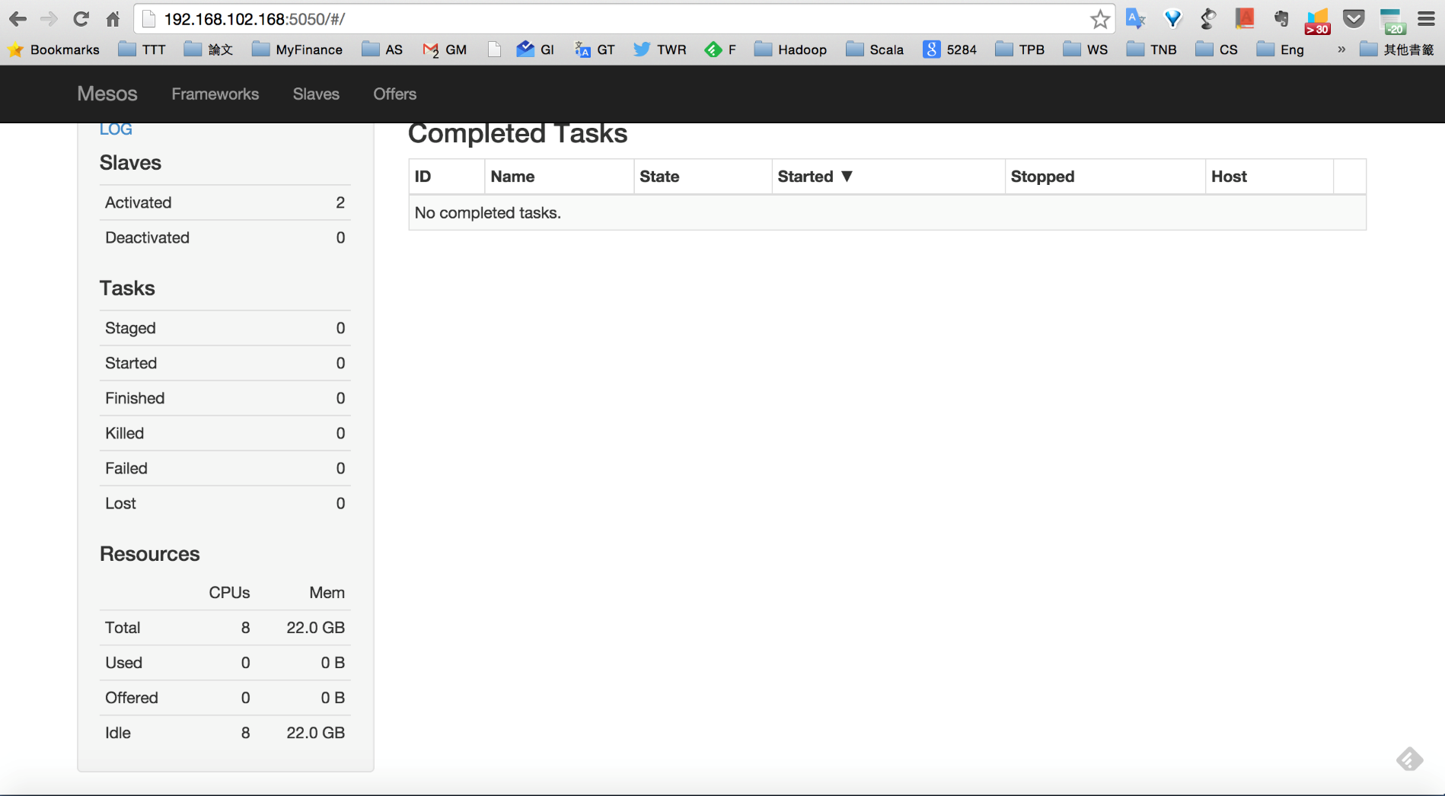
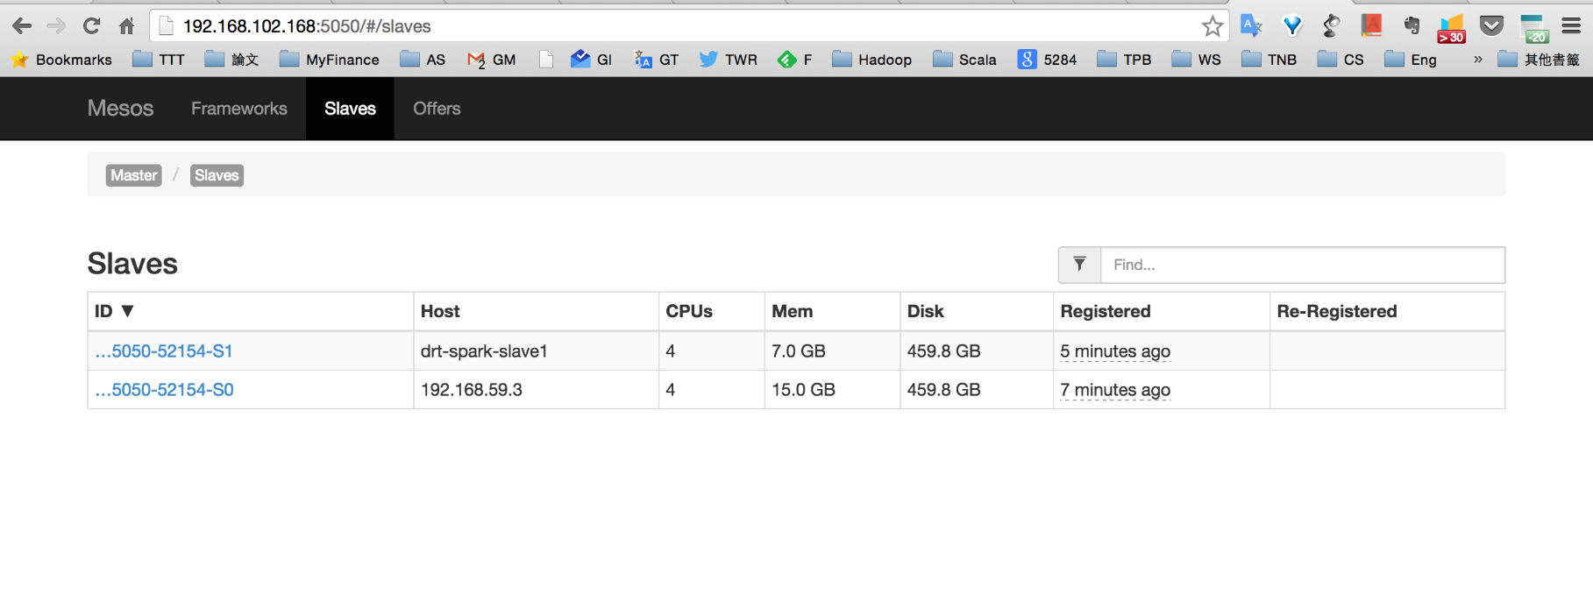
Mesos -Resource

Slide 55
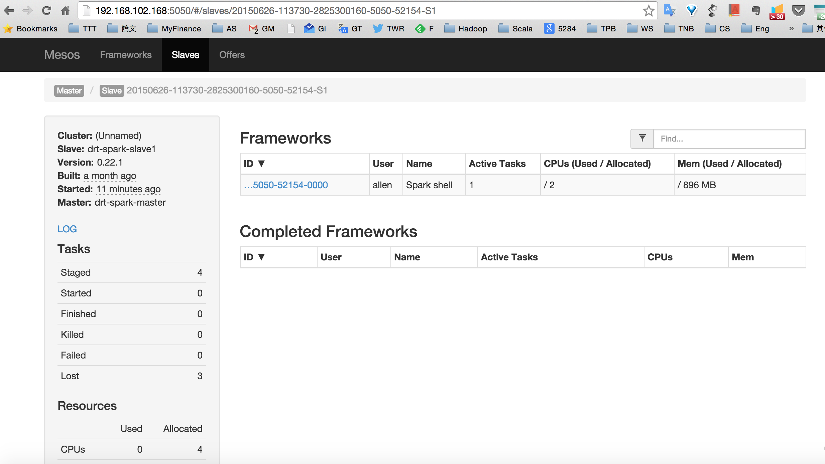
Spark on Mesos

Slide 56
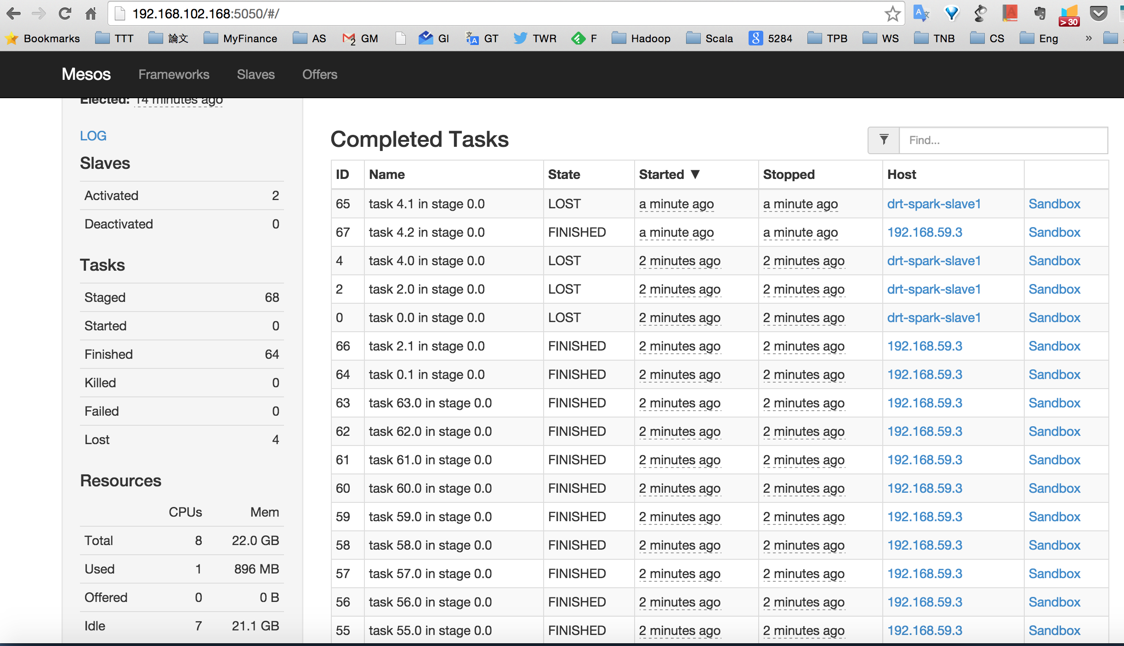
Spark on Mesos –Run Tasks

Slide 57
Conclusions
This thesis present a itinerary planning system combined with dynamic information for the Taipei public transport network.
Notes:
Pre Travel planning has always been important needs of people
----- 會議記錄 (2014/8/15 17:00) -----
增加-情境
基本目的強調
為何需要巨量分析
32000 公車站牌
十字路口
==
智慧型運輸系統
行前旅運規劃一直是重要的研究課題。
ITS係應用資訊、通信、電子、控制、運輸及管理等技術，改善既有運輸系統服務效率，優化用路人服務品質，並提昇用路安全與落實環境保護，以確保永續運輸發展之過程。
目的：提供有用、即時及動態的交通資訊，營造更智慧化、更便利的交通環境
Dr. T
使用Hadoop建置分散式巨量分析之旅運規劃系統，(Dr. T 運輸博士) 提供民眾及用路人整合及互動式旅運規劃交通資訊友善諮詢介面，將便利、有用、即時及動態之整合交通資訊提供給民眾，以利民眾行的便利。(T Language )
預估時間：
N1, StopID, RouteID, BusID, CurrentStop, DestinationStop, IsLastBus, EstimateTime, StopDistance, Direction
N1,39507,10848,222236718,39500,39515,0,599,7,0,2,140918201155,08173984,140918201155
A1,Cmp,BusID,DutyStatus,BusStatus,PathAttribueID,GoBack,X,Y,Speed,Azimuth,GPSTime
A1,800,222236672,1,0,108480,0,121.560699,25.058846,0.000000,261.059998,201447,1,140918201449,00051693,140918201449

Slide 58
Future Work
Extensions to other transportation modes as follows:
Bicycle
Rail
High Speed Rail
InterCity Bus System
Consider more detail real-time information
GPS location information for every bus
Consider of the multi-criteria itinerary planning results
Model the fare and output the Minimum fare planning results
Notes:
Pre Travel planning has always been important needs of people
----- 會議記錄 (2014/8/15 17:00) -----
增加-情境
基本目的強調
為何需要巨量分析
32000 公車站牌
十字路口
==
智慧型運輸系統
行前旅運規劃一直是重要的研究課題。
ITS係應用資訊、通信、電子、控制、運輸及管理等技術，改善既有運輸系統服務效率，優化用路人服務品質，並提昇用路安全與落實環境保護，以確保永續運輸發展之過程。
目的：提供有用、即時及動態的交通資訊，營造更智慧化、更便利的交通環境
Dr. T
使用Hadoop建置分散式巨量分析之旅運規劃系統，(Dr. T 運輸博士) 提供民眾及用路人整合及互動式旅運規劃交通資訊友善諮詢介面，將便利、有用、即時及動態之整合交通資訊提供給民眾，以利民眾行的便利。(T Language )
預估時間：
N1, StopID, RouteID, BusID, CurrentStop, DestinationStop, IsLastBus, EstimateTime, StopDistance, Direction
N1,39507,10848,222236718,39500,39515,0,599,7,0,2,140918201155,08173984,140918201155
A1,Cmp,BusID,DutyStatus,BusStatus,PathAttribueID,GoBack,X,Y,Speed,Azimuth,GPSTime
A1,800,222236672,1,0,108480,0,121.560699,25.058846,0.000000,261.059998,201447,1,140918201449,00051693,140918201449

